Slide 1
Privacy by design & case studies
George Danezis g.danezis@ucl.ac.uk
With help from:
Luca Melis luca.melis.14@ucl.ac.uk
Steve Dodier-Lazaro s.dodier-lazaro.12@ucl.ac.uk

Slide 2
GA17: Where are we at?
Communications content – E2E encryption
Communications meta-data – Anonymous communications
Computations – Homomorphic encryption / SMPC
Integrity – Zero-Knowledge proofs
Authentication / Authorization – Selective disclosure credentials
Regulations – Data protection
Data & Query anonymization – Differential privacy
Human Aspects & requirements
Storage & retrieval – PIR, ORAM, …
Case studies – putting it all together in one architecture.
+ Labs & code review!

Slide 3
Privacy by Design (PbD)
Economics of privacy engineering:
Thinking of privacy at the design stage, cheaper than at later stages.
Example 1. Alice builds a database and decides “name” & “gender” are immutable. She uses them as keys to the database records.
Example 2. Bob builds a web-site that records a lot of user activity, but presents none of it to the user. The activity is stored on a separate back end.
Problem?
Privacy-by-design approach:
Integrate thinking about privacy, and subject rights at all stages of development.
Requirements, specification, implementation, testing, deployment, maintenance.
Integrate at all stages appropriate controls to mitigate privacy risks.
George Danezis, Josep Domingo-Ferrer, Marit Hansen, Jaap-Henk Hoepman, Daniel Le Metayer, Rodica Tirtea, Stefan Schiffner. Privacy and Data Protection by Design - from policy to engineering. European Union Agency for Network and Information Security (ENISA), ISBN: 978-92-9204-108-3

Slide 4
7 principles of PbD
Proactive not Reactive; Preventative not Remedial
Privacy as the Default Setting
Privacy Embedded into Design
Full Functionality – Positive-Sum, not Zero-Sum
End-to-End Security – Full Lifecycle Protection
Visibility and Transparency – Keep it Open
Respect for User Privacy – Keep it User-Centric
“[…] these principles remain vague and leave many open questions about their application when engineering systems.” - Gurses et al (2011)
The 7 Principles: https://www.privacybydesign.ca/index.php/about-pbd/7-foundational-principles/
Gürses, Seda, Carmela Troncoso, and Claudia Diaz. "Engineering privacy by design." Computers, Privacy & Data Protection 14 (2011).

Slide 5
PbD and its discontents (I)
“Privacy by design can be reduced to a series of symbolic activities to assure consumers’ confidence, as well as the free flow of information in the marketplace”
“From a security engineering perspective, control and transparency mechanisms do not provide the means to mitigate the privacy risks that arise through the collection of data in massive databases.”
Gürses, Seda, Carmela Troncoso, and Claudia Diaz. "Engineering privacy by design." Computers, Privacy & Data Protection 14 (2011).

Slide 6
PbD and its discontents (I)
“This becomes especially problematic with respect to large-scale mandatory systems like road tolling systems and smart energy systems, or de facto mandatory systems like telecommunications (e.g., mobile phones).”
Conclusion:
“From a security engineering perspective, the risks inherent to the digital format imply that data minimization must be the foundational principle in applying privacy by design to these systems.”
Gürses, Seda, Carmela Troncoso, and Claudia Diaz. "Engineering privacy by design." Computers, Privacy & Data Protection 14 (2011).

Slide 7
A note on software architecture
We present the case study as architectures.
What is software architecture? (Shaw and Garlan 1996)
“Software architecture encompasses the set of significant decisions about the organization of a software system including the selection of the structural elements and their interfaces by which the system is composed;”
“behavior as specified in collaboration among those elements; composition of these structural and behavioral elements into larger subsystems;”
“and an architectural style that guides this organization.”
Architecture should:
Expose the structure of the system but hide the implementation details.
Realize all of the use cases and scenarios.
Try to address the requirements of various stakeholders.
Handle both functional and quality requirements.
Microsoft Application Architecture Guide, 2nd Edition. October 2009.

Slide 8
Case Study 1: e-petitions (Diaz et al. 2009)
Petitions: a formal request to an authority.
E.g. EU Lisbon Treaty: 1M people across EU may request legislation.
Two key risks: (1) Disclosure of who signed a petition (sensitive topics). (2) Discrimination or profiling on the basis of signing a petition.
Requirements:
“The signatures correspond to existing individuals.”
“Only individuals eligible to sign a petition are able to do so.”
“Each individual can sign a petition only once.”
“The number of signatures is correctly counted.”
Note: “identifiability not inherent” -> Principle of data minimization …
Claudia Diaz, Eleni Kosta, Hannelore Dekeyser, Markulf Kohlweiss, and Girma Nigusse. Privacy preserving electronic petitions. Identity in the Information Society, 1(1):203-209, 2009

Slide 9
E-Petition architecture
Registration Server
Ensure only one / same credential per person.
Authentication
& Attributes
(Encrypted)
Issue Selective Disclosure
Credential
Petition A Server (Web)
Credential show over
Anonymous channel
Prove: - Possess Credential
- Eligible
- Unique ID per petition (duplicate detection)
Petition B Server (Web)
Check inclusion over
Anonymous channel
Log of NIZK
Log of all signatures NIKZ & Public counting
Users
Petition C Server (Web)
Pattern: anonymize.
Question: Re-evaluate risks!

Slide 10
Case Study 2: Electronic Toll Pricing
Pay according to road use: time, distance, type or road, congestion.
Privacy risks: (1) Third party access to traffic / location data of driver. (2) Abuse of traffic data by authority performing the billing. (location data cannot be easily anonymized)
Requirements:
“the provider needs to know the final fee to charge;”
“the provider must be reassured that this fee is correctly computed and users cannot commit fraud”
Note: location as a means to the above -> not intrinsic.
Josep Balasch, Alfredo Rial, Carmela Troncoso, Christophe Geuens, Bart Preneel,and Ingrid Verbauwhede. PrETP: Privacy-preserving electronic toll pricing. In 19th USENIX Security Symposium, pages 63-78. USENIX Association, 2010.

Slide 11
ETP Architecture
Location
(GPS)
Location
Observations
(Speed Cameras)
Tariffs, maps, policy
On-Board-Unit
Authority
Final fee, time / location commitments, fee commitments, Homomorphic add of fee
Challenge with handful of known locations + fees), reveal commitments for this time.
Compute fee for each road segment. Compute total fee.
Note: Link between GPS-Location-fee by challenge. Question: Cap risk if one fee entry is wrong?

Slide 12
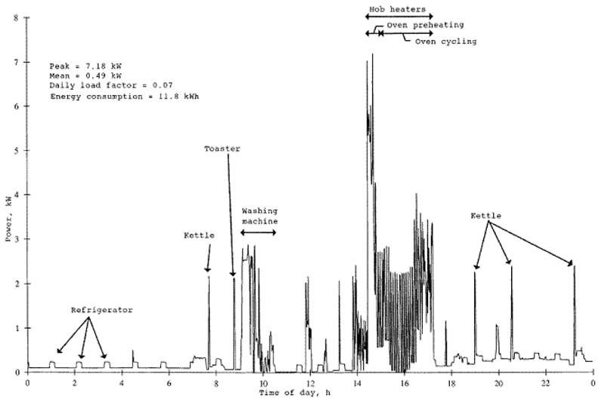
Case Study 3: Smart metering
Smart energy meters record household consumption every 30 mins.
Privacy Risks: (1) Inference of sensitive personal attributes. (Health, religion, work)
Requirements:
“Billing should be correct”
“Aggregate statistics per household or group should be available”
“Fraud / tampering detection”
Alfredo Rial and George Danezis. Privacy-Preserving Smart Metering. Proceedings of the 2011 ACM WPES 2011, Chicago, USA, October 17, 2008.
Klaus Kursawe, George Danezis, Markulf Kohlweiss: Privacy-Friendly Aggregation for the Smart-Grid. PETS 2011, Waterloo, ON, Canada, July 27-29, 2011.

Slide 13
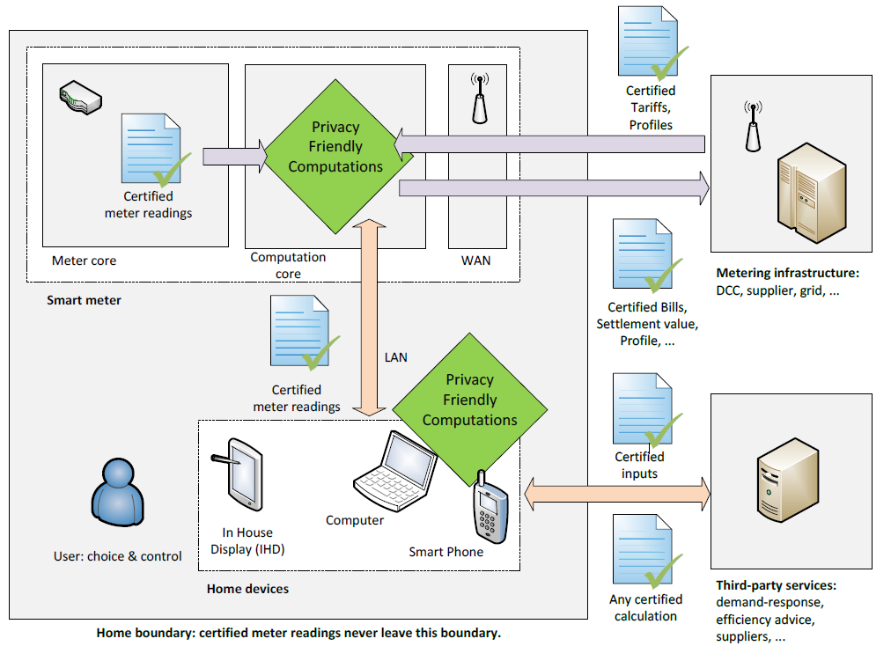
Smart meter billing architecture (I)
ZKP for correct billing
Encrypted Links
Secure H/W
ZKP for other apps

Slide 14
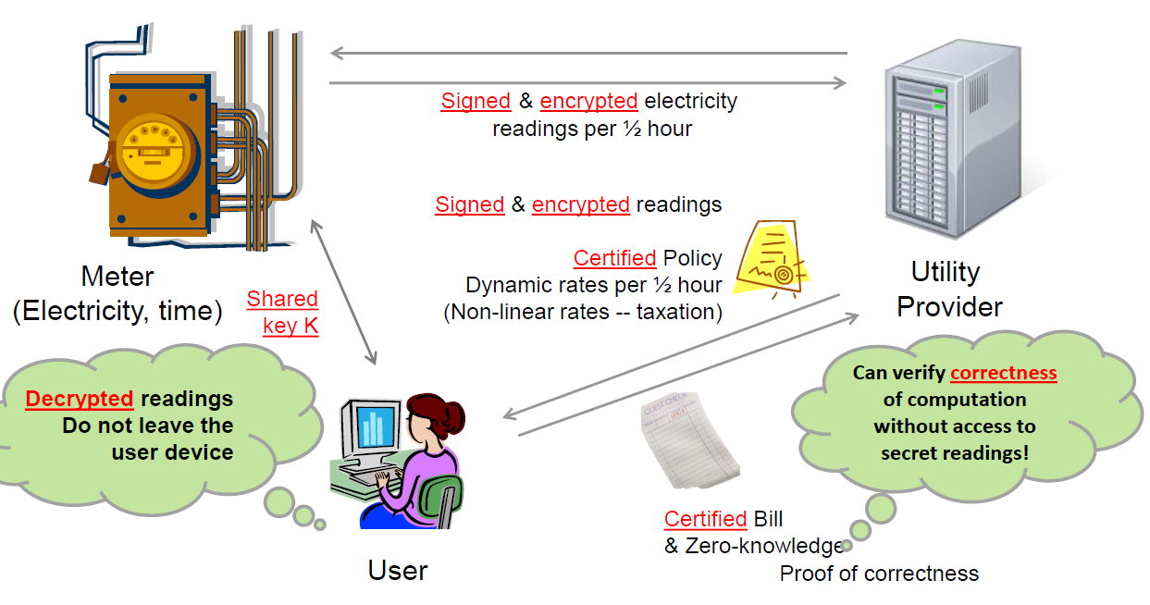
Smart meter billing architecture (II)
Note: No LAN, all data in the cloud, but encrypted
Secret sharing allows for aggregation
ZKP

Slide 15
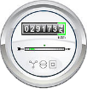
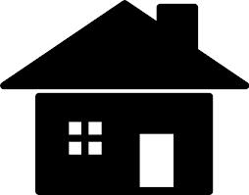
Smart Meter Architecture (III)
Remember: more than one way to architect.
Note: little user involvement
Aggregation despite failures.
Decryption / Aggregation Authorities (Access control)
$$u_{j}=\sum_{i}{w_{i}PRF_{K_{ij}}\left(T_{t}\right)−n}$$
$$s_{i}=\sum_{j}{PRF_{K_{ij}}(T_{t})}$$
y₁
y₂
Meter
(H/W)
$$c_{i}= E\left(r_{i}\right)=r_{i}+s_{i} mod 2^{32}$$
Sending encoded readings
(Secret sharing / PK Encryption)
K_{i1}
K_{i2}
x_{i}
$$u_{j}$$
$$u_{j}$$
Authorized Queries
$$w_{i}$$
$$w_{i}$$
$$w_{i}$$
$$c_{i}$$
DCC
K_{i2}, K_{i3}
$$R=\sum_{i}{w_{i}c_{i} −\sum_{j}{u_{j}}}$$
Response
(Differential privacy)
Repository of “Encrypted” Readings (Secret Sharing)
Gilles Barthe, George Danezis, Benjamin Grégoire, César Kunz, Santiago Zanella Béguelin: Verified Computational Differential Privacy with Applications to Smart Metering. CSF 2013: 287-301

Slide 16
Case Study 4: Danish Sugar Beet Auctions
Farmer contracts to produce sugar beet. Single sugar producer.
Rights / contracts are sold at an Auction
Risks: (1) Bids for contracts reveal a farmers economy (can be abused) (2) May be abused by single producer or other farmers.
Requirements:
“Run a double auction”
“Receive sealed bids”
“Compute Market Clearing Price”
“Perform trade at MCP – binding”
The Danish Sugar Beet Auctions, Tomas Toft, Aarhus University, PEC Workshop. Dec. 8th 2012

Slide 17
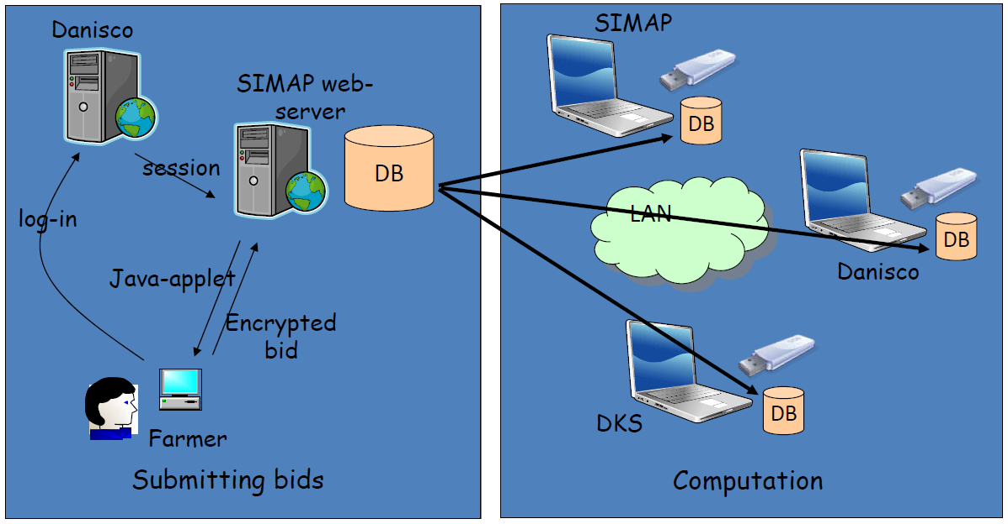
Beet Auction Architecture
Authentication / Authorization
Secret Sharing
Off line keys
Mutually distrustful parties
Danisco (Sugar Producer)
DSK (Farmers assoc.)
SIMAP (researchers)
“The auction has been run every year since 2008”

Slide 18
Case Study 5: SecureDrop for whistle blowing
Sources within Gov / Industry want to help journalists uncover wrong doing.
Privacy Risks: (1) The identity of the source may be uncovered. (2) The documents may contain too much information.
Requirements:
“Source can submit story / documents”
“Journalist may converse with source”
“Documents can be redacted / selected”
“Selected documents can be made public”
Freedom of the Press Foundation -- https://securedrop.org/

Slide 19
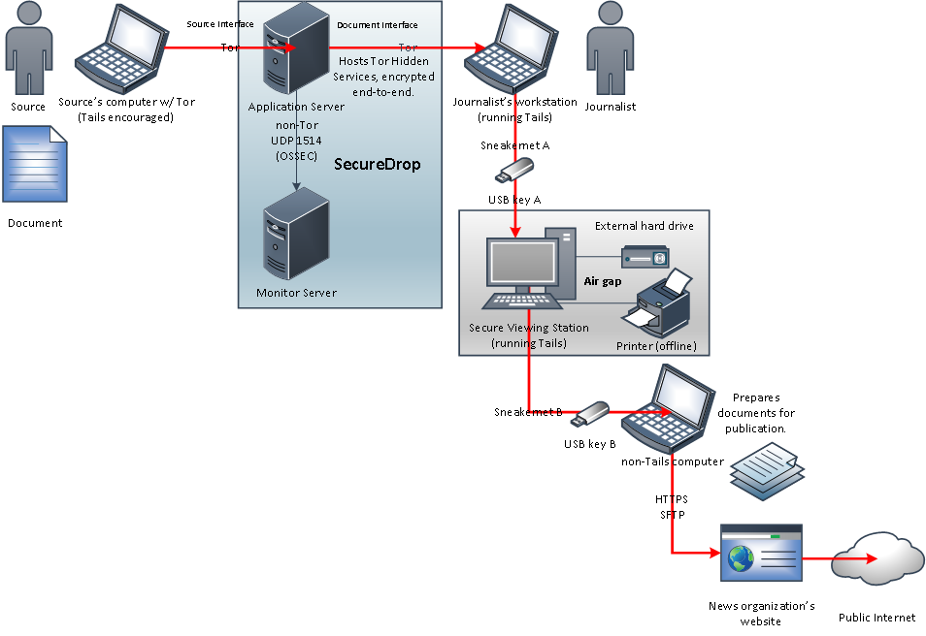
SecureDrop Architecture
Tails (OS Privacy)
Airgap (Architecture)
Tor
(anonymous comms.)
Encryption + H/W keys
(Encryption)
Lesson: Architecture can also be a privacy mechanism!
https://github.com/freedomofpress/securedrop/issues/274

Slide 20
Privacy Engineering (Gurses et al, 2011)
Process:
Functional Requirements Analysis: (Vague requirements lead to privacy problems.)
Data Minimization: (Identity or data not always necessary)
Modelling Attackers, Threats and Risks (Which parties have incentives to be hostile to the requirements)
Multilateral Security Requirements Analysis (Conflicting / contradicting security requirements of all parties)
Implementation and Testing of the Design
Crucial
Iterate
all
“If the functionality was not properly delimited in our case studies, even following our methodology, we would be forced to go for a centralized approach collecting all the data” -- Gurses et al 2009.

