Slide 1
Storage & Retrieval Privacy
George Danezis (g.danezis@ucl.ac.uk)
With help from:
Luca Melis (luca.melis.14@ucl.ac.uk)
Steve Dodier-Lazaro (s.dodier-lazaro.12@ucl.ac.uk)

Slide 2
GA17: Where are we at?
Communications content – E2E encryption
Communications meta-data – Anonymous communications
Computations – Homomorphic encryption / SMPC
Integrity – Zero-Knowledge proofs
Authentication / Authorization – Selective disclosure credentials
Regulations – Data protection
Data & Query anonymization – Differential privacy
Human Aspects & requirements
Storage & retrieval – PIR, ORAM, …
Case studies – putting it all together in one architecture.
+ Labs & code review!

Slide 3
Scope of Private Storage and Retrieval
Protecting Local storage:
Threat: stolen HD / USB stick; Malware.
Threat: compulsion to reveal encryption keys.
Protecting Remote storage:
Threat: 3rd party reading information, giving access.
Threat: patterns of access betraying private information (Both access to private or public data)
Threat: suppression, denial of service, recovery!
Efficiency considerations:
Feature: fast random access & update model.
Feature: search / select records by content.

Slide 4
Bulk Storage & Encryption
Challenges:
Disk block level (may not be a multiple of Block cipher size).
Random access reading.
Random access writing.
No extra space for an IV (Randomization) of a MAC (Integrity).
Solutions:
Use block ID as seed for IV (randomize)
Integrity? Large block cipher, file system level protections.

Slide 5
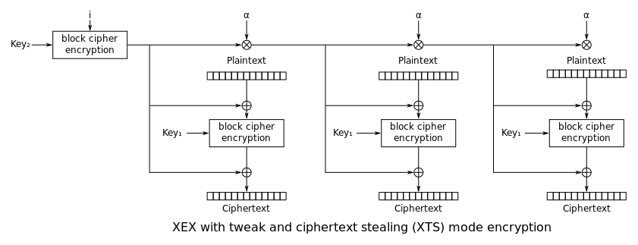
Special Modes of operation – XTS
Encryption of a single disk block i (many cipher blocks)
Tweaks
GF(2¹²⁸) Multiplication (remember GCM)
Keys
XOR
(Cipher text stealing not illustrated)
XTS, found in TrueCrypt, dm-crypt and OS X.
Image from http://en.wikipedia.org/wiki/Disk_encryption_theory

Slide 6
Case Study: Microsoft Bitlocker
Ships with Windows Vista and later…
Threat: lost laptop.
Basic idea:
Use AES-CBC to encrypt each block. Decrypt whole blocks in one go.
IV: derive from disk block number using the key.
Integrity?
No room for a MAC tag per block.
Alternative: all-or-nothing transform. In case of cipher text is modified the whole block becomes “garbage”.
“Elephant” diffuser.
Why? Avoid subtle errors by destroying all semantics.
Key management:
Tie key to computer’s Trusted Platform Module.
Allow for key escrow within an organization for recovery!

Slide 7
Deniability
Key problem: Compulsion / Coercion to reveal keys.
Communications: Perfect Forward Secrecy
Establish fresh keys for each session, delete them once done.
Result: cannot recover all sessions.
Such Deniability / Forward Secrecy is hard to achieve.
Intrinsic limit: User needs to recover encrypted data.
Therefore they may be forced to do so under coercion.
3 mechanisms to deal with coercion:
Multiple levels of ciphertext – FS steganography
Hidden message in cover – multimedia steganography.
Append only file system.
Theme: Forget Key, or plausibly pretend it does not exist.

Slide 8
Steganographic File System (StegFS)
Key idea:
Establish a hierarchy of levels and keys K₀, K₁, K₂, …
When operating at level K_{i} one knows all keys K_{j}, j < I
Store different file systems, one at each level.
Allow for collisions deletions, through error correction.
Impossible to prove or disprove there is one more level …
?
?
?
2) Select positions and encrypt blocks using K₁ unless already occupied.
K₁
1) Select positions and encrypt blocks using K₀.
K₀
0) Initialize with random blocks
Random blocks
Andrew D. McDonald, Markus G. Kuhn: StegFS: A Steganographic File System for Linux. Information Hiding 1999: 462-477

Slide 9
Steganographic Media Embedding
Key Idea:
Embed a “stego” text into a “cover” image / sound / video.
Use regions of “randomness” to make new image inconspicuous.
Ensure all statistics of the image are indistinguishable from normal images.
Use secret key to chose locations to embed and encrypt text.
Result: can plausibly deny that some content is present.
Encoding
Decoding
Store Image
K
K
Katzenbeisser, Stefan, and Fabien Petitcolas. Information hiding techniques for steganography and digital watermarking. Artech house, 2000.

Slide 10
Forward secrecy in append only storage
Key idea:
Input key K₀ into the system, and store it off-line somewhere safe.
Encrypt each entry m_{i} with key K_{i} and the update the key.
Update using a hash function: K_{i+1} = H(K_{i}). Delete K_{i}.
m₀
encrypt
K₀
store
update
m₁
encrypt
K₁
update
m₂
encrypt
K₂
update
Example use:
Protect Sequential Images taken by Camera.
K₃

Slide 11
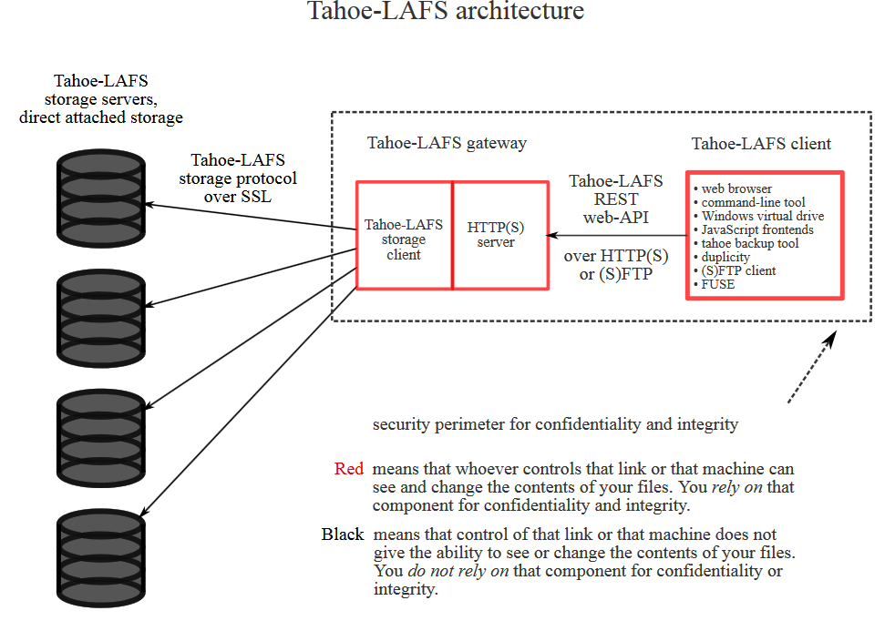
Private Remote Storage
Remote storage:
Wish to store and retrieve blocks on remote server.
Protect against eavesdroppers and corrupt service.
Key: secure cloud storage.
Case Study: Tahoe-LAFS (Least Authority File System)
Confidentiality relies on client side components.
Crypto used to protect data.
Servers are not “trusted”.
Multiple servers used for high availability.
Compare with: Dropbox, …
Image and more info at https://www.tahoe-lafs.org/

Slide 12
Hiding access patterns to private storage
Secure client-side cloud storage:
Good: confidentiality, Integrity and availability of content.
Lacking: traffic analysis of block reads / writes.
Patterns of access may leak information about activities / content.
Technique: Oblivious Random Access Memory (ORAM)
Objective: use limited local storage to hide patterns of access to larger remote storage.
Here: present access protocol.
Note I: may also modify protocol to write blocks.
Note II: more efficient protocols may be used in practice.

Slide 13
ORAM Insights
Client may store a small number of items locally (Shelter).
Initialization:
Store a randomly permuted sequence of the blocks π(i) on server.
To access (read or write) block i:
Check whether the block i is in the local shelter.
Yes: read + write a random new position on the remote server and place it in shelter.
No: read + write position π(i) and store item i in the shelter.
When shelter is full, obliviously permute afresh the remote database (hard!) .
Access i
Access j
Security argument: every access i leads to a statistically independent access j.

Slide 14
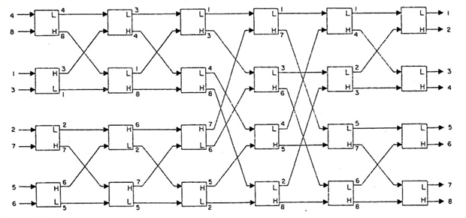
ORAM & Oblivious shuffles
How can you implement an oblivious shuffle, with limited local storage?
Answer: An oblivious sorting network
Secret permutation:
Retrieve, permute, store

Slide 15
Hiding Public accesses – PIR
Public, shared, databases but confidential accesses:
Privacy concern: the pattern of access to public data may reveal private attributes.
Example 1: You lookup whether a URL may be malicious on an online database -> probably you are about to download / render that page.
Example 2: You are looking at a database entry on a medical condition -> you or someone close to you may be affected by this condition.
Example 3: You query the presence record of another user -> you are friends with that user.
Private Information Retrieval
Objective: Access a public database record, without allowing the server to know which record you are accessing.
Is it possible? Yes, trivial PIR = download the full database.
Therefore PIR protocols must be more efficient than download the full DB.
However, the server needs to do O(N) work for N records. (Why?)
Chor, Benny, et al. "Private information retrieval." Journal of the ACM (JACM) 45.6 (1998): 965-981.

Slide 16
A simple PIR system
Setup:
Consider a database of N records.
Trivial download O(N).
Shape the database into a square matrix M of size √N x √N = N
Query record i:
Identify the row j holding record i.
Generate a key for an additively homomorphic encryption scheme (eg. Paillier)
Make a vector v of ciphertexts, one for each row: E(0) for all rows, except the target row j.
Send the row to the server that computes and return v⋅M
Decrypt the returned row and retrieve the sought item.

Slide 17
PIR in pictures
Client:
Server:
v
v =
E₀
E₀
E₁
E₀
M =
m_{i}
j=2
Encryptions of 0 or 1
Public data in clear
Decrypt: m_{i-2}, m_{i-1}, m_{i}, m_{i+1}
v·M
v·M =
E
E
Em₁
E
Cost?
- Comms: 2 x √N
- Compute: N
Why does that work?
m · E(0) = E(m · 0) = E(0)
m · E(1) = E(m · 1) = E(m)
E(0) + E(0) + E(m) + E(0) = E(m)

Slide 18
Multi-Server PIR
Costs of Single Server PIR:
1 homomorphic operation per item O(N)
Ciphertext expansion. Eg. Paillier ciphertext is 2 x 2048 bits.
Too much …
Multiserver PIR:
Assume k servers, include at least 1 honest.
Use secret sharing for the encryption of 0 or 1 (as <0> or <1>)
Otherwise same: m · <0> = <0> and m · <1> = <m>
Each server combines shared query with DB and returns result shares.
Cost:
Communications 2 · k · √N
Computations: O(N)
In practice: bottleneck is the memory fetch time – paralelize!

Slide 19
Multi-Server PIR – in pictures
Client:
Server k:
v
v =
<0>
<0>
<1>
<0>
M =
m_{i}
j=2
Shares of 0 or 1
Public data in clear
Reassemble shares: m_{i-2}, m_{i-1}, m_{i}, m_{i+1}
v·M
v·M =
<.>
<.>
<m>
<.>
Cost?
- Comms: 2 x k x √N
- Compute: N per server
- Small fields (mod 2³¹-1)
Why does that work?
m · <0> = <m · 0> = <0>
m · <1> = <m · 1> = <m>
<0> + <0> + <m> + <0> = <m>

Slide 20
Searching Private data
Goal: Alice stores her email remotely, and she wants to retrieve all emails containing a specific keyword.
Trivial Solution:
Pre-build an index of keywords -> emails.
Download the full index (not just for one word!)
Do the query locally and retrieve the emails concerned only.
Question: what does this mechanism leak?

Slide 21
Deterministic, order preserving encryption
Trivial mechanism leaks:
The volume of messages retrieved.
The record ID of the messages retrieved.
Adversary: may detect future queries to same term through those.
Adversary: may construct a map of: Anonymous Queries -> message sets (Remember how hard it is to anonymize graphs)
Mechanisms that leak no more than the above, at a lower cost:
Deterministic encryption: “E(m) -> c” always the same “c”.
Order preserving encryption: E(m₀) -> c₀ and E(m₁) -> c₁: if m₀ < m₁ then c₀ < c₁
Warning: Weaker than proper, randomized, encryption.
Mechanism: use DE to encrypt index terms -> emails IDs. Query the store by DE(keyword), retrieve encrypted index chunk, retrieve messages.
Seny Kamara, Charalampos Papamanthou, Tom Roeder: Dynamic searchable symmetric encryption. ACM Conference on Computer and Communications Security 2012: 965-976

Slide 22
Private Search on Streaming Data
Goal: A large organization has a high-volume feed of data. Alice wishes to retrieve a subset that matches certain keywords, without revealing those keywords.
Mechanism: uses additively homomorphic encryption.
1) Alice constructs map: keyword i -> E(I_{i}) where I_{i} = 0 or 1 2) Send map to filter.
3) Filter constructs a buffer of (E(0), E(0)) of size k log(N)
4) For each document filter:
for all keywords i in m_{i} : Sum_{i} E(I_{i}), Sum_{i} E(I_{i})^{mi} 5) Select 3 psedorandom location h(i) -> locations Add the 2 ciphertexts to those locations.
6) Send the buffer to Alice, that decrypts it, resolves collisions and recovers (short) documents.
Rafail Ostrovsky, William E. Skeith III: Private Searching on Streaming Data. J. Cryptology 20(4): 397-430 (2007)

