Slide 1
Privacy Enhancing Technologies Anonymous Communications.
George Danezis (g.danezis@ucl.ac.uk)
With help from:
Luca Melis (luca.melis.14@ucl.ac.uk)
Steve Dodier-Lazaro (s.dodier-lazaro.12@ucl.ac.uk)

Slide 2
Administration & Labs
Enrol into the moodle for M067/GA17.
  Enrolment key “pets”.
  Information, slides & links …
State of the Labs.
  More documentation on petlib:
  http://petlib.readthedocs.org/en/latest/
  A “readme” with command line help and hints and help:
  https://github.com/gdanezis/PET-Exercises/blob/master/Lab01Basics/Lab01Readme.txt
  Unit tests grouped by task to help you manage them.
  (“git pull” will update your exercises directory in the VM)
Labs: How are you doing?

Slide 3
Network identity today
Neither privacy nor authenticity / integrity
No anonymity
No identification
Weak identifiers everywhere:
  IP, MAC
  Logging at all levels
  Login names / authentication
  PK certificates in clear
Also:
  Location data leaked
  Application data leakage
Weak identifiers easy to modulate
  Expensive / unreliable logs.
  IP / MAC address changes
  Open Wi-Fi access points
  Bot-nets
Partial solution
  Authentication
Open issues:
  DoS and network level attacks

Slide 4
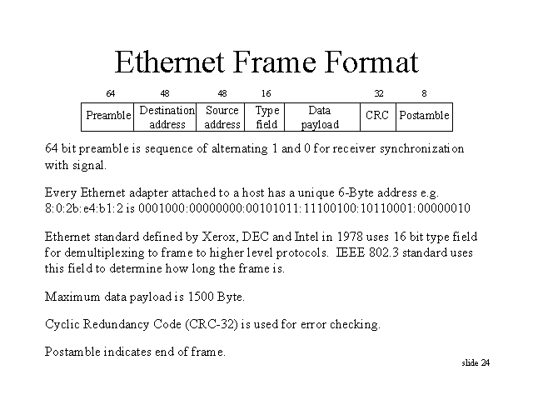
Ethernet packet format
Anthony F. J. Levi - http://www.usc.edu/dept/engineering/eleceng/Adv_Network_Tech/Html/datacom/
No integrity or
authenticity
MAC Address

Slide 5
IP packet format
3.1. Internet Header Format
A summary of the contents of the internet header follows:
0 1 2 3
0 1 2 3 4 5 6 7 8 9 0 1 2 3 4 5 6 7 8 9 0 1 2 3 4 5 6 7 8 9 0 1
+-+-+-+-+-+-+-+-+-+-+-+-+-+-+-+-+-+-+-+-+-+-+-+-+-+-+-+-+-+-+-+-+
|Version| IHL |Type of Service| Total Length |
+-+-+-+-+-+-+-+-+-+-+-+-+-+-+-+-+-+-+-+-+-+-+-+-+-+-+-+-+-+-+-+-+
| Identification |Flags| Fragment Offset |
+-+-+-+-+-+-+-+-+-+-+-+-+-+-+-+-+-+-+-+-+-+-+-+-+-+-+-+-+-+-+-+-+
| Time to Live | Protocol | Header Checksum |
+-+-+-+-+-+-+-+-+-+-+-+-+-+-+-+-+-+-+-+-+-+-+-+-+-+-+-+-+-+-+-+-+
| Source Address |
+-+-+-+-+-+-+-+-+-+-+-+-+-+-+-+-+-+-+-+-+-+-+-+-+-+-+-+-+-+-+-+-+
| Destination Address |
+-+-+-+-+-+-+-+-+-+-+-+-+-+-+-+-+-+-+-+-+-+-+-+-+-+-+-+-+-+-+-+-+
| Options | Padding |
+-+-+-+-+-+-+-+-+-+-+-+-+-+-+-+-+-+-+-+-+-+-+-+-+-+-+-+-+-+-+-+-+
Example Internet Datagram Header
Figure 4.
RFC: 791
INTERNET PROTOCOL
DARPA INTERNET PROGRAM
PROTOCOL SPECIFICATION
September 1981
Link different
packets together
Weak identifiers
Same for TCP, SMTP, IRC, HTTP, ...
No integrity / authenticity

Slide 6
Anonymity in communications
Specialized applications
  Electronic voting
  Auctions / bidding / stock market
  Incident reporting
  Witness protection / whistle blowing
  Showing anonymous credentials!
General applications
  Freedom of speech
  Profiling / price discrimination
  Spam avoidance
  Investigation / market research
  Censorship resistance

Slide 7
Anonymity properties (1)
Sender anonymity
  Alice sends a message to Bob. Bob cannot know who Alice is.
Receiver anonymity
  Alice can send a message to Bob, but cannot find out who Bob is.
Bi-directional anonymity
  Alice and Bob can talk to each other, but neither of them know the identity of the other.

Slide 8
Anonymity properties (2)
3rd party anonymity
  Alice and Bob converse and know each other, but no third party can find this out.
Unobservability
  Alice and Bob take part in some communication, but no one can tell if they are transmitting or receiving messages.
Unlinkability
  Two messages sent (received) by Alice (Bob) cannot be linked to the same sender (receiver).
Pseudonymity
  All actions are linkable to a pseudonym, which is unlinkable to a principal (Alice)

Slide 9
High-Latency Anonymity Systems
Mix Networks

Slide 10
Anonymity through Broadcast
Point 1: Do not re-invent this
E(Junk)
Point 2: Many ways to do
broadcast
- Ring
- Trees
It has all been done (Buses)
Simple receiver
anonymity
E(Message)
Point 3: Is your anonymity
system better than this?
E(Junk)
Point 4: What are the
problems here?
Coordination
Sender anonymity
Latency
Bandwidth
E(Junk)
E(Junk)

Slide 11
Mix – practical anonymity
David Chaum (concept 1979 – publish 1981)
  Reference is marker in anonymity bibliography
Makes uses of cryptographic relays
  Break the link between sender and receiver
Cost
  O(1) – O(logN) messages
  O(1) – O(logN) latency
Security
  Computational (public key primitives must be secure)
  Threshold of honest participants

Slide 12
The mix – illustrated
M->B: Msg
A->M: {B, Msg}_{Mix}
Alice
Bob
The Mix
Adversary cannot
see inside the Mix

Slide 13
The mix – security issues
1) Bitwise unlinkability
?
M->B: Msg
A->M: {B, Msg}_{Mix}
Alice
Bob
The Mix
?
2) Traffic analysis resistance

Slide 14
Mix security (contd.)
Bitwise unlinkability
  Ensure adversary cannot link messages in and out of the mix from their bit pattern
  Cryptographic problem
Traffic analysis resistance
  Ensure the messages in and out of the mix cannot be linked using any meta-data (timing, ...)
  Two tools: delay , inject or drop traffic –add cost!

Slide 15
Two broken mix designs (1)
Broken bitwise unlinkability
  The `stream cipher’ mix (Design 1)
  {M}_{Mix} = {fresh k}_{PKmix}, M ⊕ Stream_{k}
k
Stream Cipher
,
k
Message
PKMix
Active attack?
A->M: {B, Msg}_{Mix}
M->B: Msg
Alice
Bob
Tagging Attack
Adversary intercepts {B, Msg}_{Mix}
and injects {B, Msg}_{Mix} ⊕ (0,Y).
The mix outputs message:
M->B: Msg ⊕ Y
And the attacker can link them.
The Mix

Slide 16
Lessons from broken design 1
Mix acts as a service
  Everyone can send messages to it; it will apply an algorithm and output the result.
  That includes the attacker – decryption oracle, routing oracle, ...
(Active) Tagging attacks
  Defence 1: detect modifications (CCA2)
  Defence 2: destroy all information (Mixminion, Minx)

Slide 17
GA17 Lab 2 – Implement a simple mix client
Note: the second lab will be on implementing a simple mix client, and fixing aspects of a mix server.

Slide 18
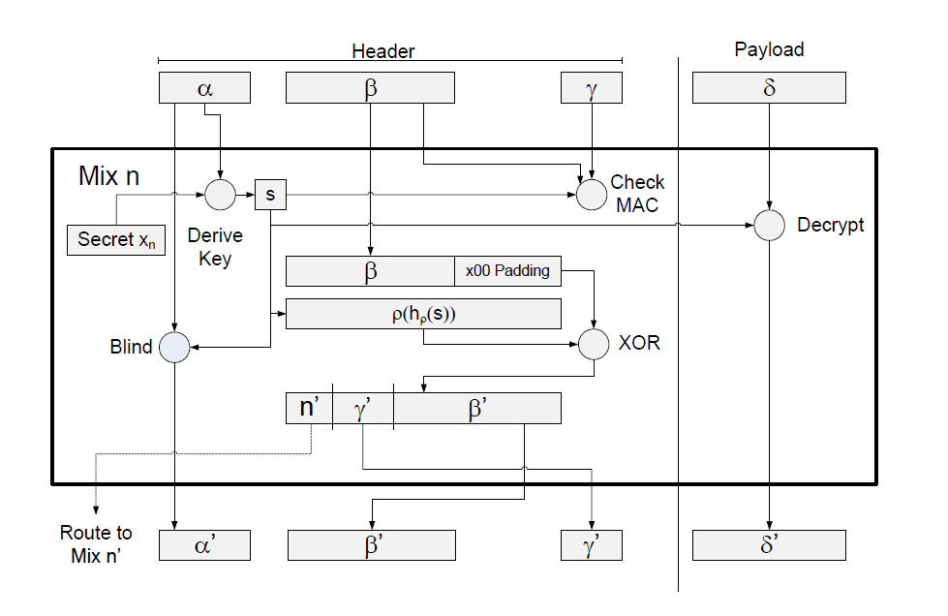
Insight into a Modern message format
Input
Processing
inside
MIx
Output
George Danezis & Ian Goldberg. Sphinx: A Compact and Provably Secure Mix Format. IEEE S&P ‘09.

Slide 19
Two broken mix designs (2)
Broken traffic analysis resistance
  The `FIFO*’ mix (Design 2)
  Mix sends messages out in the order they came in!
Passive attack?
A->M: {B, Msg}_{Mix}
M->B: Msg
Alice
Bob
The adversary simply counts the
number of messages, and assigns
to each input the corresponding
output.
The Mix
* FIFO = First in, First out

Slide 20
Lessons from broken design 2
Mix strategies – ‘mix’ messages together
  Threshold mix: wait for N messages and output them in a random order.
  Pool mix: Pool of n messages; wait for N inputs; output N out of N+n; keep remaining n in pool.
  Timed, random delay, ...
“Hell is other people” – J.P. Sartre
  Anonymity security relies on others
  Problem 1: Mix must be honest
  Problem 2: Other honest sender-receiver pairs to hide amongst
Threshold Mix
Pool Mix
Pool

Slide 21
Distributing mixing
Rely on more mixes – good idea
  Distributing trust – some could be dishonest
  Distributing load – fewer messages per mix
Two extremes
  Mix Cascades
    All messages are routed through a preset mix sequence
    Good for anonymity – poor load balancing
  Free routing
    Each message is routed through a random sequence of mixes
    Security parameter: L then length of the sequence

Slide 22
The free route example
A->M₂: {M₄, {M₁,{B, Msg}_{M1}}_{M4}}_{M2}
The Mix
(The adversary should
get no more information
than before!)
Free route
mix network
Alice
Bob
M₁
M₂
M₃
M₄
M₅
M₆
M₇

Slide 23
Free route mix networks
Bitwise unlinkability
  Length invariance
  Replay prevention
How to find mixes?
  Lists need to be authoritative, comprehensive & common
Additional requirements – corrupt mixes
  Hide the total length of the route
  Hide the step number
  (From the mix itself!)
Length of paths?
  Good mixing in O(log(|Mix|)) steps = log(|Mix|) cost
  Cascades: O(|Mix|)
We can manage “Problem 1 – trusting a mix”

Slide 24
Problem 2 – who are the others?
The (n-1) attack – active attack
  Wait or flush the mix.
  Block all incoming messages (trickle) and injects own messages (flood) until Alice’s message is out.
1
Alice
Bob
The Mix
n
Attacker

Slide 25
Mitigating the (n-1) attack
Strong identification to ensure distinct identities
  Problem: user adoption
Message expiry
  Messages are discarded after a deadline
  Prevents the adversary from flushing the mix, and injecting messages unnoticed
Heartbeat traffic
  Mixes route messages in a loop back to themselves
  Detect whether an adversary is blocking messages
  Forces adversary to subvert everyone, all the time
General instance of the “Sybil Attack”

Slide 26
Robustness to Denial of Service (DoS)
Malicious mixes may be dropping messages
  Special problem in elections
Original idea: receipts (unworkable)
Two key strategies to prevent DoS
  Provable shuffles – will not cover here.
  Randomized partial checking

Slide 27
Randomized partial checking
Applicable to any mix system
Two round protocol
  Mix commits to inputs and outputs
  Gets challenge
  Reveals half of correspondences at random
  Everyone checks correctness
Pair mixes to ensure messages get some anonymity

Slide 28
Partial checking – illustrated
Mix i
Mix i+1
Reveal half
Reveal other half
Slight lie
Rogue mix can cheat with probability at most ½
Messages are anonymous with overwhelming probability in the length L
  Even if no pairing is used – safe for L = O(logN)

Slide 29
Receiver anonymity
Cryptographic reply address
  Alice sends to bob: M₁,{M₂, k₁,{A,{K}_{A}}_{M2}}_{M1}
    Memory-less: k₁ = H(K, 1) k₂ = H(K, 2)
  Bob replies:
    B->M1: {M₂, k₁, {A,{K}_{A}}_{M2}}_{M1}, Msg
    M1->M2: {A,{K}_{A}}_{M2} , {Msg}_{k1}
    M2->A: {K}_{A}, {{Msg}_{k1}}_{k2}
  Security: indistinguishable from other messages

Slide 30
Basic Traffic Analysis
Anonymity is more fragile than communications privacy!

Slide 31
Fundamental limits
What is traffic analysis:
  The discipline of inferring information from patterns of traffic.
  Applied to security: assume content is encrypted; traffic is anonymized:
  Traffic analysis of “hardened targets”
Even perfect anonymity systems leak information when participants change
Setting:
  N senders / receivers – Alice is one of them
  Alice messages a small number of friends:
    R_{A} in {Bob, Charlie, Debbie}
    Through a MIX / DC-net
    Perfect anonymity of size K
  Can we infer Alice’s friends?

Slide 32
Setting
Alice
    r_{A} in R_{A}= {Bob, Charlie, Debbie}
Anonymity
System
K-1 Senders
out of N-1
others
K-1 Receivers
out of N
others
(Model as random receivers)
Alice sends a single message to one of her friends
Anonymity set size = K
Entropy metric E_{A} = log K
Perfect!

Slide 33
Many rounds
Alice
    r_{A1}
Anonymity
System
Observe many rounds in which Alice participates
Rounds in which Alice participates will output a message to her friends!
Infer the set of friends!
T₁
Others
Others
Alice
    r_{A2}
T₂
Anonymity
System
Others
Others
Alice
    r_{A3}
Anonymity
System
T₃
Others
Others
Alice
    r_{A4}
T₄
Anonymity
System
Others
Others
...
T_{t}

Slide 34
Hitting set attack (1)
Guess the set of friends of Alice (R_{A}’)
  Constraint |R_{A}’| = m
Accept if an element is in the output of each round
Downside: Cost
  N receivers, m size – (N choose m) options
  Exponential – Bad
Good approximations...

Slide 35
Statistical disclosure attack
Note that the friends of Alice will be in the sets more often than random receivers
How often? Expected number of messages per receiver:
  μ_{other} = (1 / N) ∙ (K-1) ∙ t
  μ_{Alice} = (1 / m) ∙ t + μ_{other}
Just count the number of messages per receiver when Alice is sending!
  μ_{Alice} > μ_{other}

Slide 36
Comparison: HS and SDA
Parameters: N=20 m=3 K=5 t=45 KA={[0, 13, 19]}
Round Receivers SDA SDA_error #Hitting sets
1 [15, 13, 14, 5, 9] [13, 14, 15] 2 685
2 [19, 10, 17, 13, 8] [13, 17, 19] 1 395
3 [0, 7, 0, 13, 5] [0, 5, 13] 1 257
4 [16, 18, 6, 13, 10] [5, 10, 13] 2 203
5 [1, 17, 1, 13, 6] [10, 13, 17] 2 179
6 [18, 15, 17, 13, 17] [13, 17, 18] 2 175
7 [0, 13, 11, 8, 4] [0, 13, 17] 1 171
8 [15, 18, 0, 8, 12] [0, 13, 17] 1 80
9 [15, 18, 15, 19, 14] [13, 15, 18] 2 41
10 [0, 12, 4, 2, 8] [0, 13, 15] 1 16
11 [9, 13, 14, 19, 15] [0, 13, 15] 1 16
12 [13, 6, 2, 16, 0] [0, 13, 15] 1 16
13 [1, 0, 3, 5, 1] [0, 13, 15] 1 4
14 [17, 10, 14, 11, 19] [0, 13, 15] 1 2
15 [12, 14, 17, 13, 0] [0, 13, 17] 1 2
16 [18, 19, 19, 8, 11] [0, 13, 19] 0 1
17 [4, 1, 19, 0, 19] [0, 13, 19] 0 1
18 [0, 6, 1, 18, 3] [0, 13, 19] 0 1
19 [5, 1, 14, 0, 5] [0, 13, 19] 0 1
20 [17, 18, 2, 4, 13] [0, 13, 19] 0 1
21 [8, 10, 1, 18, 13] [0, 13, 19] 0 1
22 [14, 4, 13, 12, 4] [0, 13, 19] 0 1
23 [19, 13, 3, 17, 12] [0, 13, 19] 0 1
24 [8, 18, 0, 10, 18] [0, 13, 18] 1 1
Round 16:
Both attacks give correct result
SDA: Can give wrong results – need more evidence

Slide 37
HS and SDA (continued)
25 [19, 4, 13, 15, 0] [0, 13, 19] 0 1
26 [13, 0, 17, 13, 12] [0, 13, 19] 0 1
27 [11, 13, 18, 15, 14] [0, 13, 18] 1 1
28 [19, 14, 2, 18, 4] [0, 13, 18] 1 1
29 [13, 14, 12, 0, 2] [0, 13, 18] 1 1
30 [15, 19, 0, 12, 0] [0, 13, 19] 0 1
31 [17, 18, 6, 15, 13] [0, 13, 18] 1 1
32 [10, 9, 15, 7, 13] [0, 13, 18] 1 1
33 [19, 9, 7, 4, 6] [0, 13, 19] 0 1
34 [19, 15, 6, 15, 13] [0, 13, 19] 0 1
35 [8, 19, 14, 13, 18] [0, 13, 19] 0 1
36 [15, 4, 7, 13, 13] [0, 13, 19] 0 1
37 [3, 4, 16, 13, 4] [0, 13, 19] 0 1
38 [15, 13, 19, 15, 12] [0, 13, 19] 0 1
39 [2, 0, 0, 17, 0] [0, 13, 19] 0 1
40 [6, 17, 9, 4, 13] [0, 13, 19] 0 1
41 [8, 17, 13, 0, 17] [0, 13, 19] 0 1
42 [7, 15, 7, 19, 14] [0, 13, 19] 0 1
43 [13, 0, 17, 3, 16] [0, 13, 19] 0 1
44 [7, 3, 16, 19, 5] [0, 13, 19] 0 1
45 [13, 0, 16, 13, 6] [0, 13, 19] 0 1
SDA: Can give wrong results – need more evidence

Slide 38
Disclosure attack family
Counter-intuitive
  The larger N the easiest the attack
Hitting-set attacks
  More accurate, need less information
  Slower to implement
  Sensitive to Model
    E.g. Alice sends dummy messages with probability p.
Statistical disclosure attacks
  Need more data
  Very efficient to implement (vectorised) – Faster partial results
  Can be extended to more complex models (pool mix, replies, ...)
The Future: Bayesian modelling of the problem

Slide 39
Summary of key points
Near-perfect anonymity is not perfect enough!
  High level patterns cannot be hidden for ever
  Unobservability / maximal anonymity set size needed
Flavours of attacks
  Very exact attacks – expensive to compute
    Model inexact anyway
  Statistical variants – wire fast!

Slide 40
Low Latency Anonymity Systems
Tor, and all that …

Slide 41
Onion Routing
Anonymising streams of messages
  Example: Tor (The onion router)
As for mix networks
  Alice chooses a (short) path
  Relays a bi-directional stream of traffic to Bob
Cells of traffic
Onion
Router
Onion
Router
Onion
Router
Alice
Bob
Bi-directional

Slide 42
Onion Routing vs. Mixing
Setup route once per connection
  Use it for many cells – save on public key operations
No time for delaying
  Usable web latency 1—2 sec round trip
  Short routes – Tor default 3 hops
  No batching (no threshold , ...)
Passive attacks!

Slide 43
Stream Tracing
Adversary observes all inputs and outputs of an onion router
Objective: link the ingoing and outgoing connections
(to trace from Alice to Bob)
Key insight: timing of packets are correlated
Two techniques:
  Correlation
  Template matching

Slide 44
Tracing (1) – Correlation
Onion
Router
1
3
2
1
2
2
1
2
3
0
3
2
T=0
IN_{i}
T=0
OUT_{i}
Number of cell
per time interval
Bucket input and output packets over time bins. Normalize around zero.
Compute:
  Corr = ∑_{i} IN_{i}∙OUT_{i}
Downside: lose precision by bucketing.

Slide 45
Tracing (2) – Template matching
Input Stream
Onion
Router
Output Stream
IN_{Template}
Compare with template
v_{i}
Use input and delay curve to make template
  Prediction of what the output will be
Assign to each output cell the template value (v_{i}) for its output time
Multiply them together to get a score (∏_{i}v_{i})

Slide 46
The security of Onion Routing
Cannot withstand a global passive adversary
  (Tracing attacks too expensive to foil)
Partial adversary
  Can see some of the network
  Can control some of the nodes
Secure if adversary cannot see first and last node of the connection
  If c is fraction of corrupt servers
  Compromise probability = O(c²)
No point making routes too long

Slide 47
Extending the route in Tor
Alice
OR₁
OR₂
OR₃
Bob
Authenticated DH
Alice – OR₁
K₁
Authenticated DH, Alice – OR₂
Encrypted with K₁
K₂
Authenticated DH, Alice – OR₃
Encrypted with K₁, K₂
K₃
TCP Connection with Bob, Encrypted with K₁, K₂, K₃

Slide 48
Some remarks
Encryption of input and output streams under different keys provides bitwise unlinkability
  As for mix networks
  Is it really necessary?
Authenticated Diffie-Hellman
  One-sided authentication: Alice remains anonymous
  Alice needs to know the signature keys of the Onion Routers
  Scalability issue – 1000 routers x 2048 bit keys
  Advantage: Perfect Forward Secrecy!

Slide 49
Summary of key concepts on Anonymity
Anonymity requires a crowd
  Difficult to ensure it is not simulated – (n-1) attack
  Making one on your own expensive (broadcast)
Mix networks – Practical anonymous messaging
  Bitwise unlinkability / traffic analysis resistance
  Crypto: Decryption vs. Re-encryption mixes
  Distribution: Cascades vs. Free route networks
  Robustness: Partial checking
Onion Routing – Supports interactive streams
  Only withstands a partial adversary.
  Very widely deployed (Tor: The onion router)

